Slide 1

MELODICA MEDIA CORP DATA JOURNEY: SSIS DATA WAREHOUSE DEVELOPMENT, POWER BI, AND SSAS TABULAR ANALYSIS
Team 2

Slide 2

Our team
Amalia Adamantidou
Alexandros Koutzimpasopoulos
Georgios Stamatopoulos
Nikolaos Stavrou
Nikolaos Charalampos Chairopoulos

Slide 3
Project Scope
The objective of this project was to create a data warehouse from an OLTP database using data analysis tools. The data warehouse is scheduled to be regularly updated with new data. Additionally, we aimed to present the insights derived from the data analysis, employing Power BI and SSAS Tabular tools.
Thematic Area
Description
Data Cleaning
Excluded non-essential data from OLTP based on relevance and importance
Database Creation: Staging and DW
Creation of Staging and DW (STAR schema) databases
Tools used: SQL Server Integration Services (SSIS) and SQL Server Management Studio (SSMS)
Data Processing with SSAS
Utilized SQL Server Analysis Services (SSAS) for advanced data processing.
Visualization with Power BI
Employed POWER BI for data visualization and strategic analysis.

Slide 4
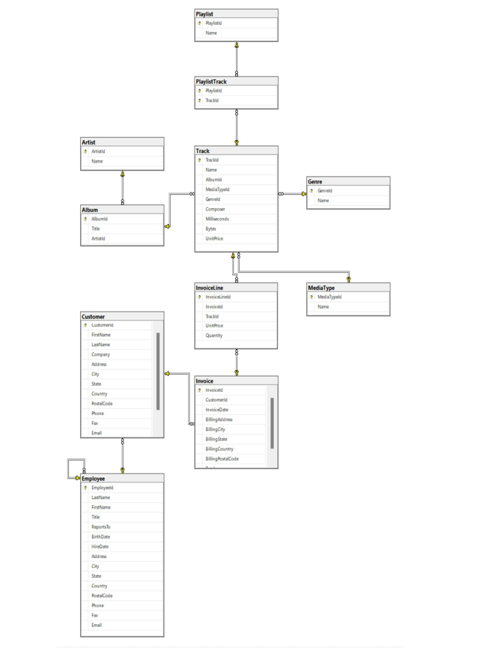
OLTP
Starting Diagram of OLTP Database including relationships between tables.

Slide 5
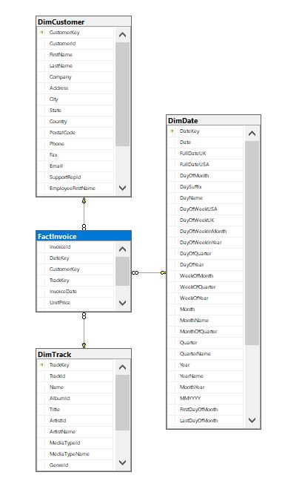
Data Warehouse
KEY POINTS
3 dimensions to keep track of significant data Did not include data about playlists – no added value For Employees: Only names of “Supportrep”
Ending Diagram of Data Warehouse including relationships between Fact & Dimensions

Slide 6
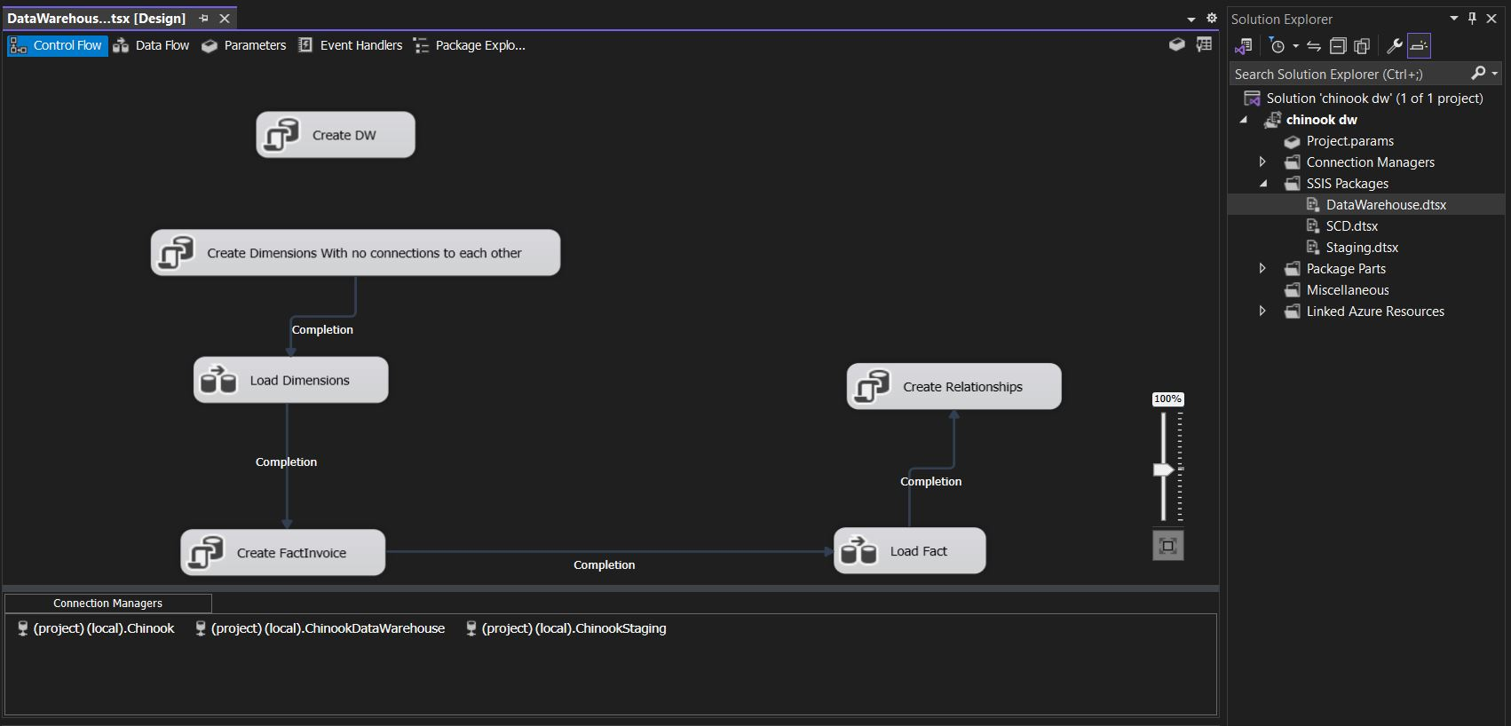
SSIS Packages Control Flow
Example of SSIS Package for the creation of the Data Warehouse

Slide 7
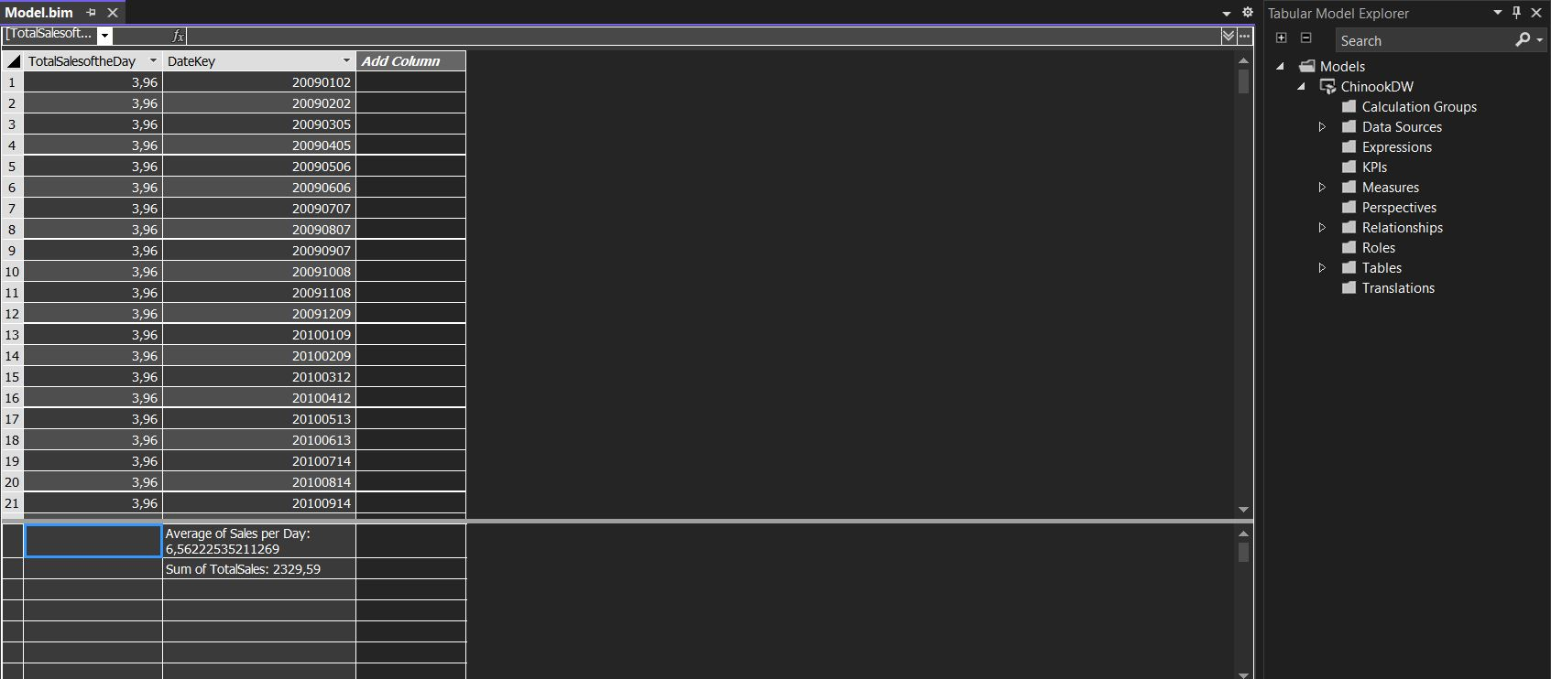
SSAS Tabular
Example of Measures and Calculated Tables using SSAS Tabular

Slide 8
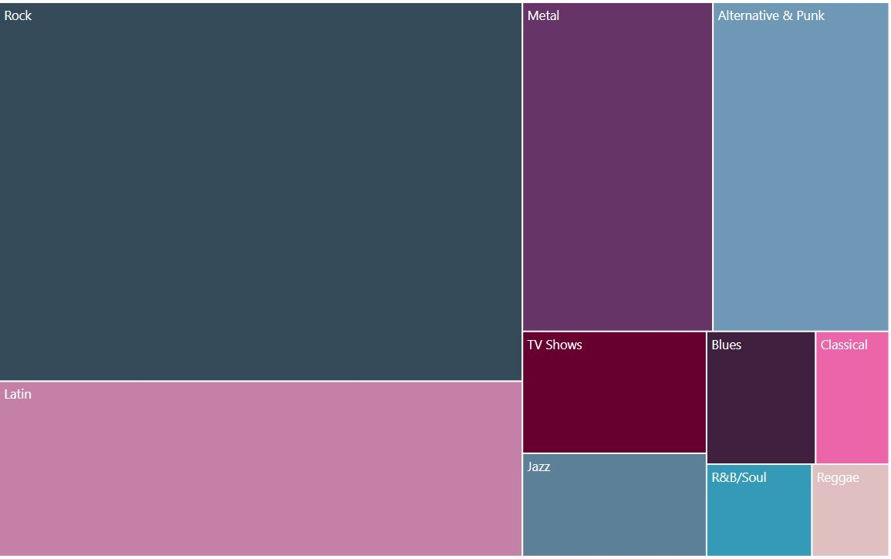
Data Analysis using Power BI (1)
Treemap Diagram of Top 10 Genres by Track Sales

Slide 9
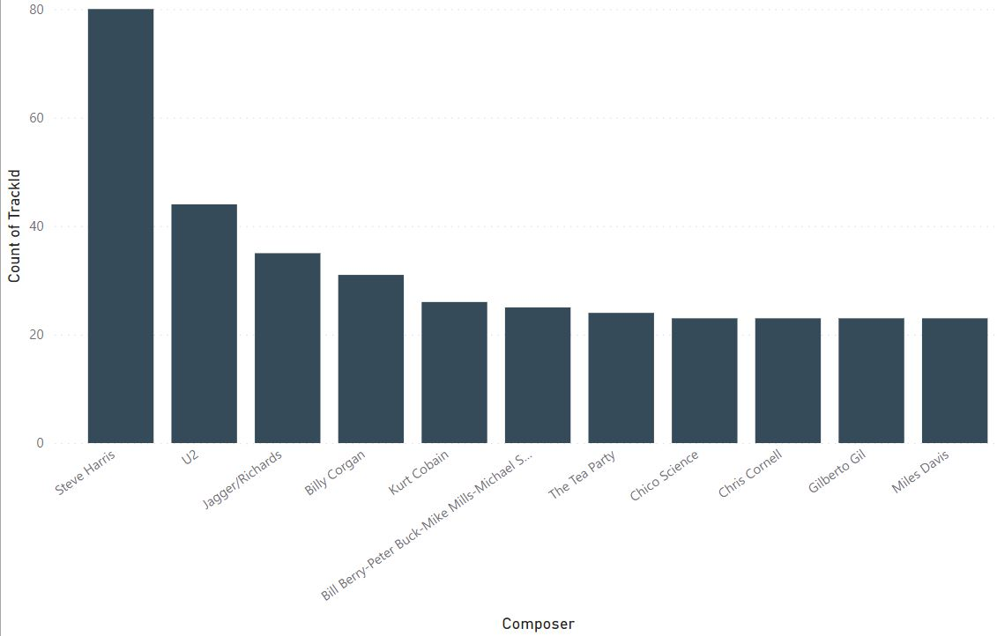
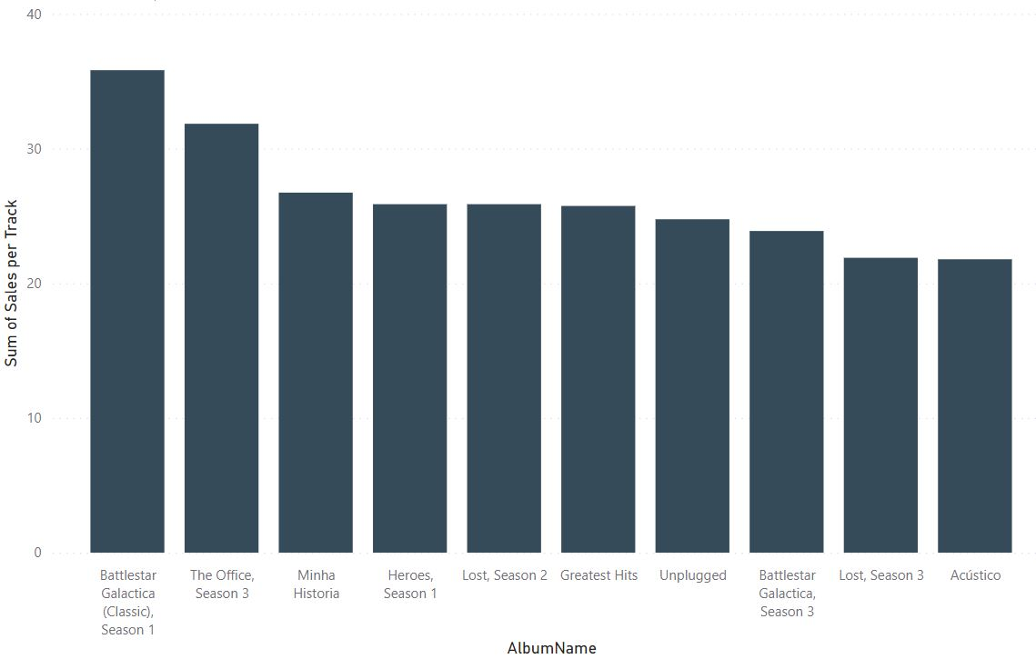
Data Analysis using Power BI (2)
Top 10 Composers by Number of Tracks
Top 10 Albums by Track Sales

Slide 10
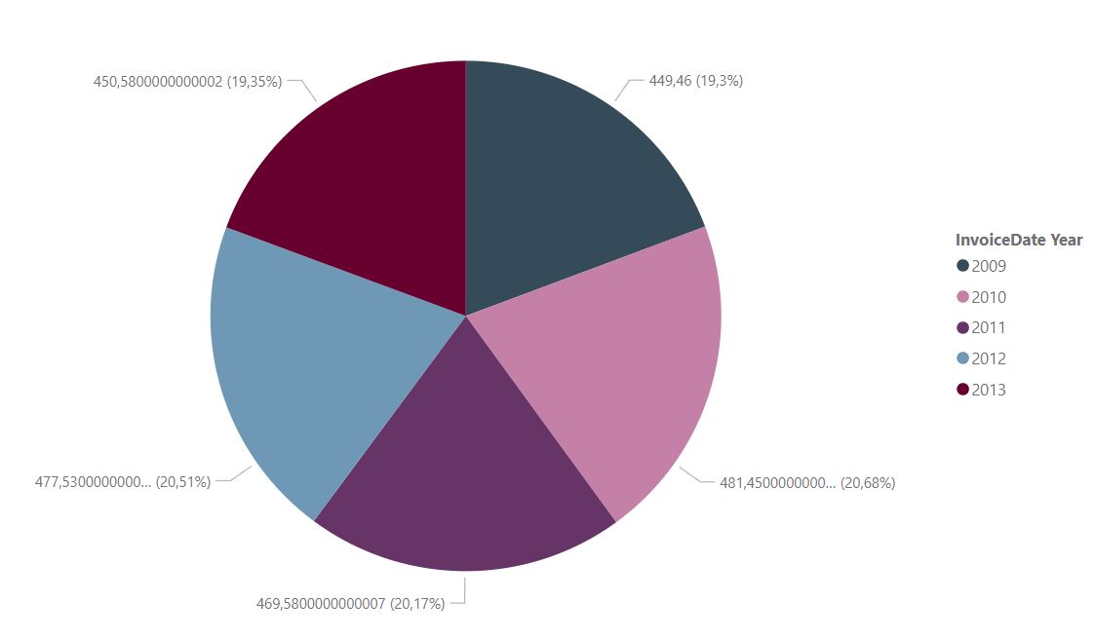
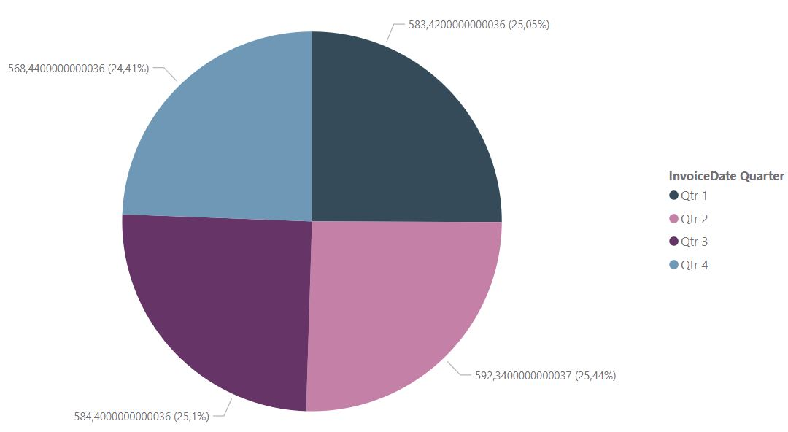
Data Analysis using Power BI (3)
Track Sales Per Year
Month | Sales
January | 201,12
February | 187,20
March | 195,10
April | 198,14
May | 193,10
June | 201,10
July | 190,10
August | 198,10
September | 196,20
October | 193,10
November | 186,24
December | 189,10
Track Sales Per Quarter
NOTES:
The sales of tracks don’t show any time dependency

Slide 11
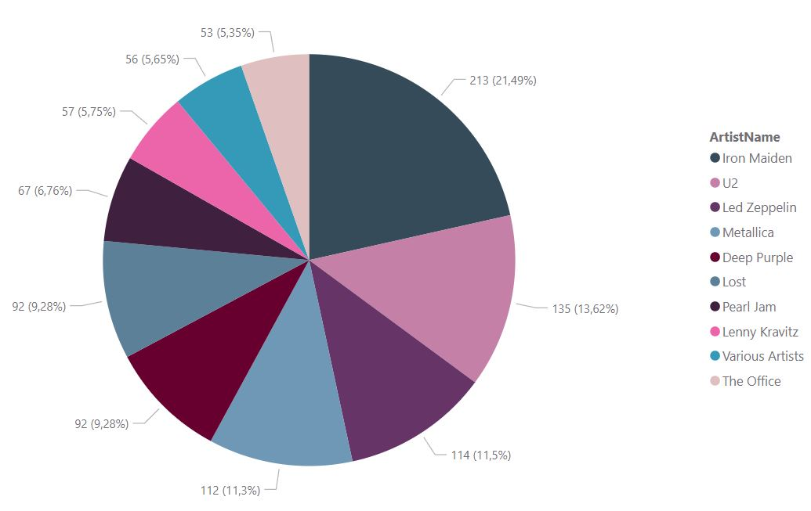
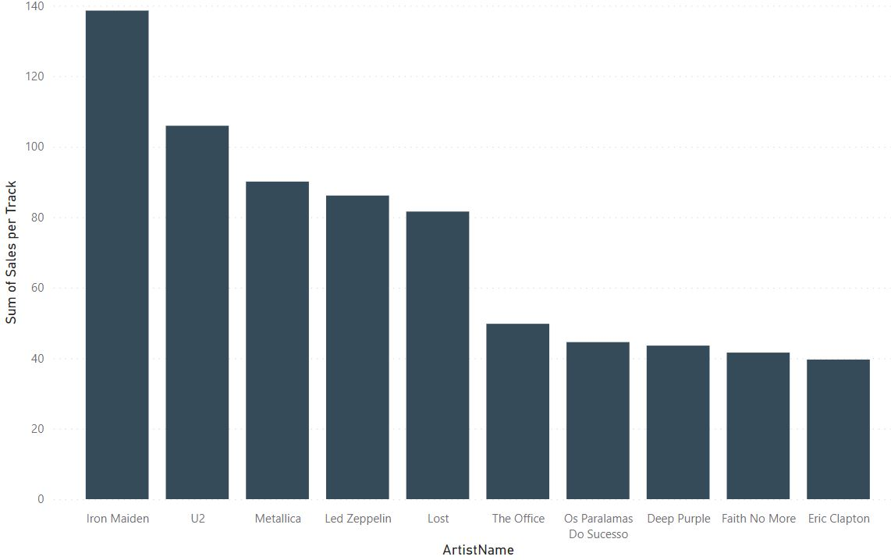
Data Analysis using Power BI (4)
Top 10 Artists by Number of Tracks
Top 10 Artists by Number of Sales
Proposals
Promotion for the top 5 Artists for their great performance on our sales
Advertise Artists with the least sales

Slide 12
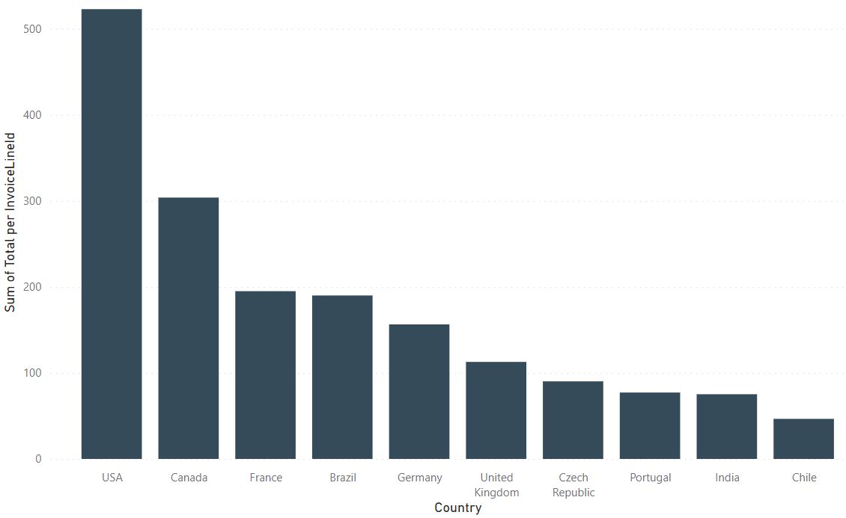
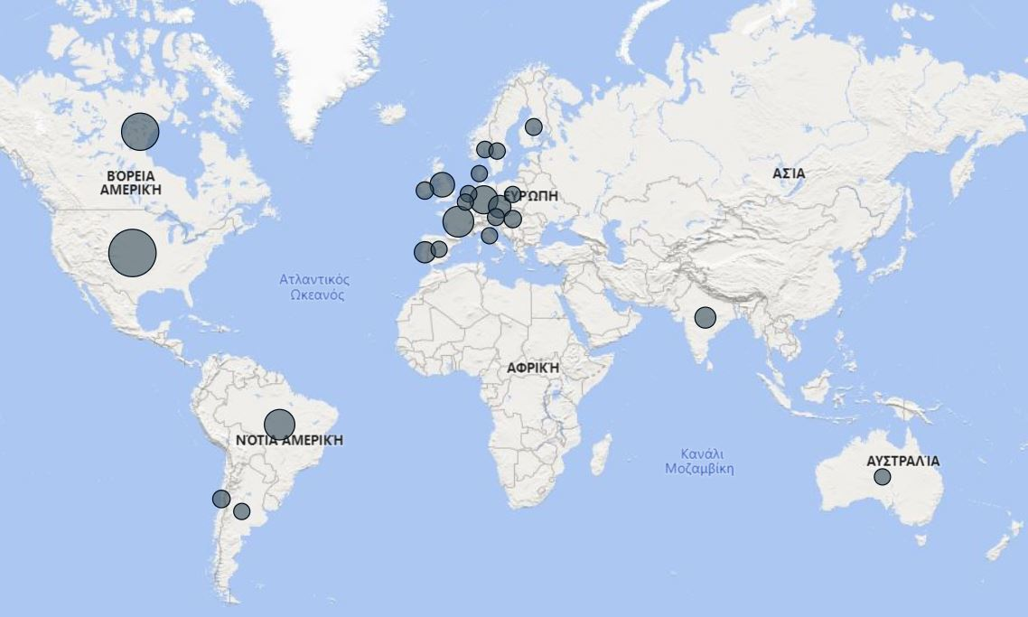
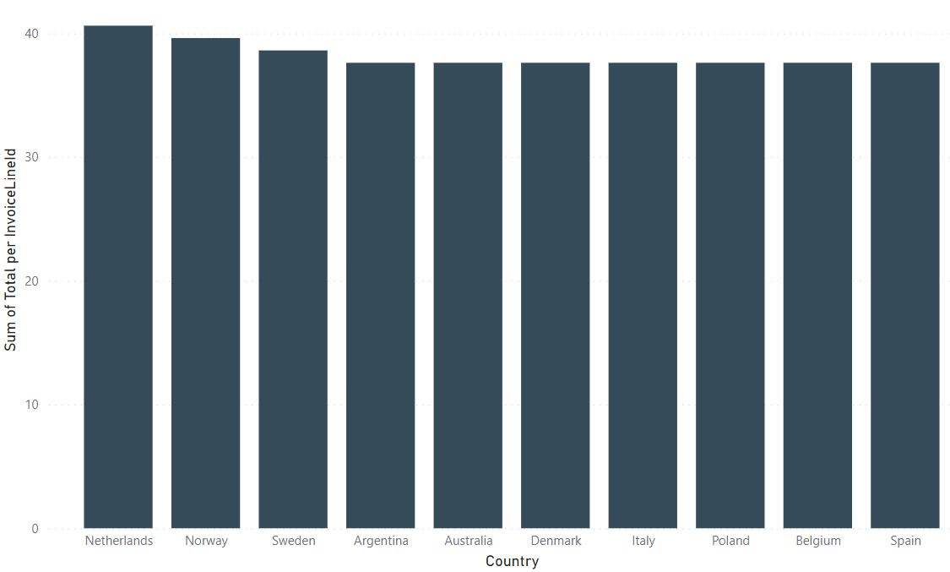
Data Analysis using Power BI (5)
Top 10 Countries by Purchases
Bottom 10 Countries by Purchases
Proposals
Advertisements in the European region, where sales appear to be lagging behind the US
Develop activities in regions where there are no sales at all (East Asia and Africa)

Slide 13
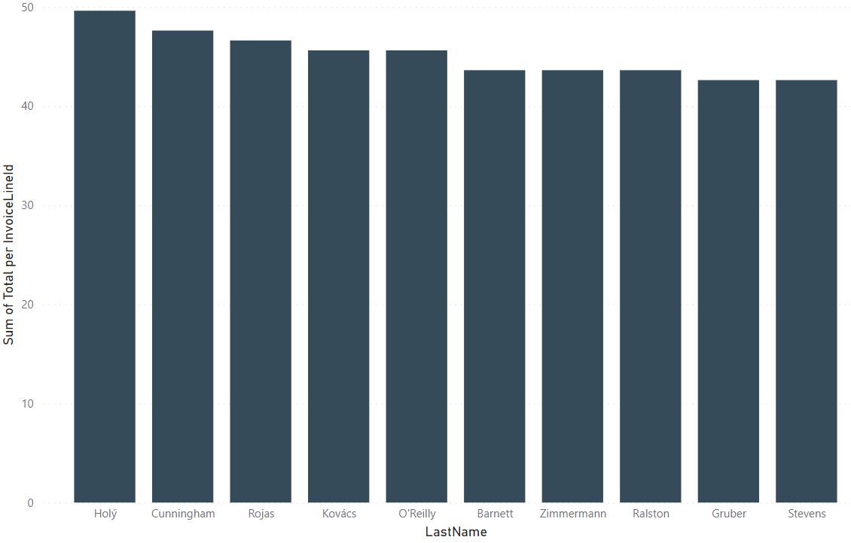
Data Analysis using Power BI (6)
Proposal:
Discount policies and targeted emails to our best buyers
More Advertisements to customers with the least purchases
Top 10 Customers by Number of Purchases

Slide 14
Conclusion
SSMS, SSIS, SSAS and Power BI have proven invaluable tools in gaining actionable insights and driving informed decision-making. Specifically:
SSMS: Efficiently extract, transform, and load large volumes of data from various sources, ensuring data integrity and accuracy Visual Studio (SSIS & SSAS): provided a robust and user-friendly environment for developing queries without the need for complex programming knowledge, enabling us to perform complex data manipulations, aggregations, and calculations Power BI: Ability to create visually appealing and interactive dashboards and reports that presented measures and trends in a comprehensive manner. These visualizations allowed us to quickly identify patterns

Slide 15
Thank You!

